Slide 1
Cloud Security Basics
Server & Cloud Security
4

Slide 2
Contents
Overview of Virtualization and Cloud Computing
Cloud Deployment Models and Service Modules
Shared Responsibility Model
Identity and Access Management (IAM)

Slide 3
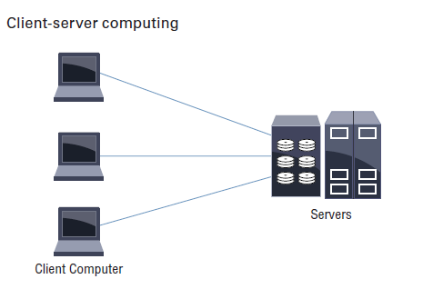
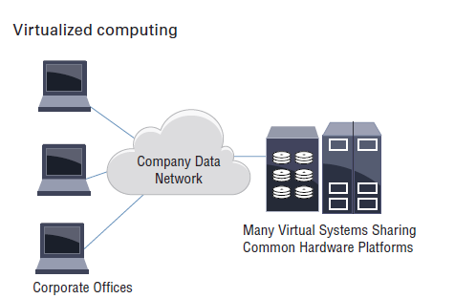
Overview of Virtualization
Today the virtualization of hardware resources has exploded to fully utilize the processing capabilities of a server and reduce power consumption, cooling, and the footprint in data centers.

Slide 4
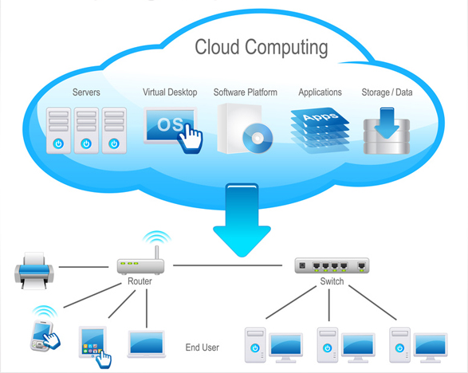

From Virtualization to Cloud Computing
Virtualization is the enabling technology for Cloud Computing.

Slide 5
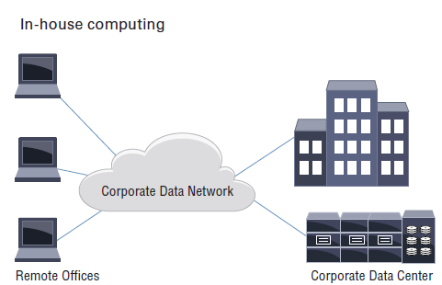
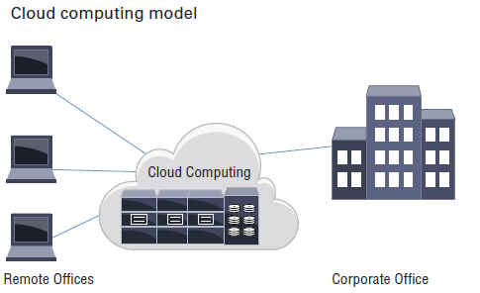
Overview of Cloud Computing
Cloud computing is essentially outsourcing data center operations, applications, or a section of operations to a provider of computing resources often called a cloud company or cloud service provider.

Slide 6
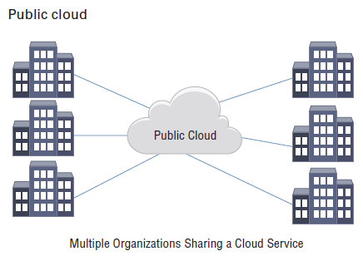
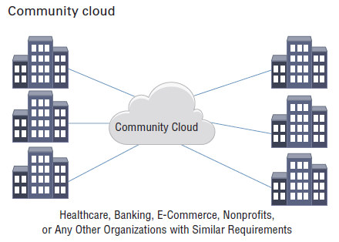
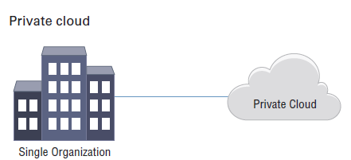
Cloud Deployment Models
Private: Infrastructure is provisioned for exclusive use by a single organization with multiple consumers.
Community: Infrastructure is provisioned for exclusive use by a specific community of consumers from organizations that have shared concerns.
Public: Infrastructure is provisioned for open use by the general public.
Hybrid: Infrastructure is a composition of two or more distinct cloud infrastructures, private, community, or public which remain unique entities.

Slide 7
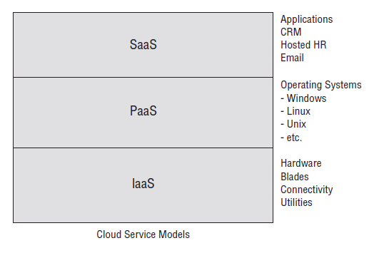
Cloud Service Models
Infrastructure as a Service (IaaS)
The most basic of cloud service offerings, IaaS allows the customer to install all software, including operating systems (OSs) on hardware housed and connected by the cloud vendor.
Platform as a Service (PaaS)
Software as a Service (SaaS)

Slide 8
Cloud Service Models
Platform as a Service (PaaS)
PaaS contains everything included in IaaS, with the addition of OSs. The cloud vendor usually offers a selection of OSs, so that the customer can use any or all of the available choices.
The capability provided to the consumer is to deploy onto the cloud infrastructure consumer-created or -acquired applications created using programming languages and tools supported by the provider.
Software as a Service (SaaS)
SaaS includes everything listed in the IaaS & PaaS models, with the addition of software programs.

Slide 9



Cloud Service Models Analogy
If you just moved to a new city and you are looking for a place to live, you are thinking of:
Build a new house?
You can fully control everything you
like your new house to have.
But that is a hard work
Buy an empty house?
You can customize some part of your
house. But never change the original
architecture.
Live in a hotel?
There is nothing you can do with the
house except living in it.

Slide 10
Cloud Service Models Analogy
What if you want to have an IT department ?
Similar to build a new house
You can rent some virtualized infrastructure and build up your own IT system among those resources, which may be fully controlled.
Technical speaking, use the Infrastructure as a Service (IaaS) solution.
Similar to buy an empty house
You can directly develop your IT system through one cloud platform, and do not care about any lower level resource management.
Technical speaking, use the Platform as a Service (PaaS) solution.
Similar to live in a hotel
You can directly use some existed IT system solutions, which were provided by some cloud application service provider, without knowing any detail technique about how these service was achieved.
Technical speaking, use the Software as a Service (SaaS) solution.

Slide 11

Shared Responsibility Model

Slide 12
Shared Responsibility Model
Cloud service providers adhere to a shared security responsibility model, which means the cloud consumer’s security team maintains some responsibilities for security as they move applications, data, containers, and workloads to the cloud, while the provider takes some responsibility, but not all.
The definitions of the shared responsibility security model can vary between service providers and can change based on whether the consumers are using IaaS, PaaS or SaaS.

Slide 13
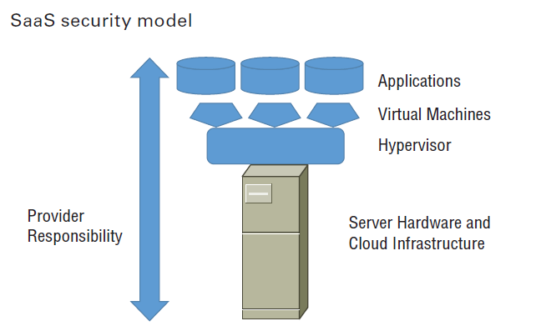
Shared Responsibility Model - SaaS
The Software as a Service model is where the customer of the service accesses application software that is owned and controlled by the cloud company, which has complete responsibility for the management and support of the application.

Slide 14
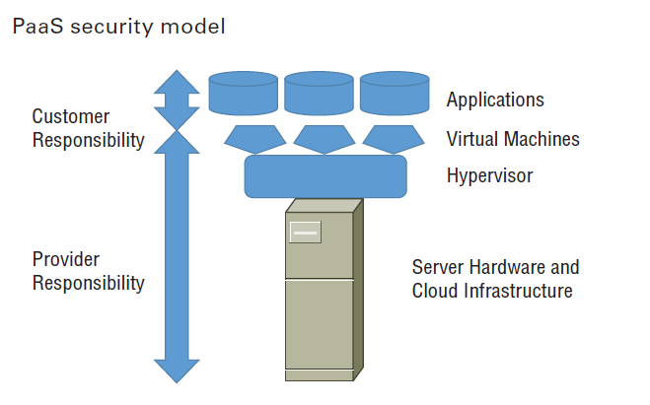
Shared Responsibility Model - PaaS
The security demarcation for PaaS is that the cloud provider assumes responsibility for security up to the operating system, and the customer manages the application and operating system configuration.

Slide 15
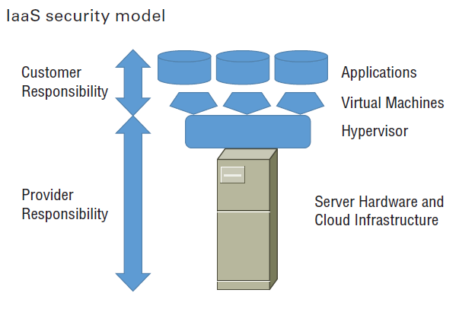
Shared Responsibility Model - IaaS
In IaaS service model, the service provider will be responsible for all cloud infrastructure up to the hypervisor level. The customer is responsible for the VM and higher.

Slide 16
Shared Responsibility Model Example
From Cloud Service Provider - AWS
Notes:
This section covers the shared responsibility model.

Slide 17
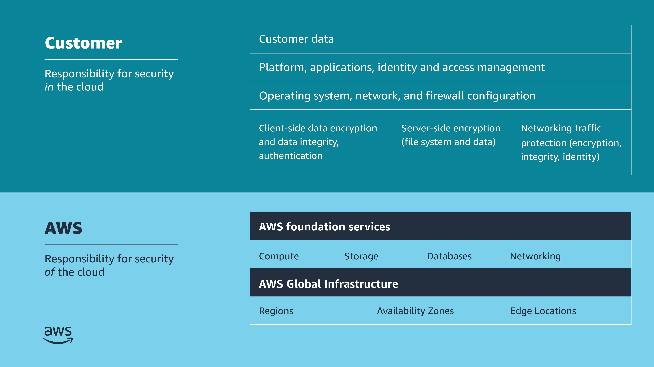
AWS shared responsibility model
Notes:
For accessibility: Shared responsibility model listing customer and AWS responsibilities. Customer is responsible for security in the cloud. This includes customer data. Platform, applications, identity and access management. Operating system, network, and firewall configuration. Client-side data encryption and data integrity, authentication. Server-side encryption of file system and data. Networking traffic protection, to include encryption, integrity, and identity. AWS is responsible for security of the cloud. This includes the AWS foundation services for compute, storage, databases, and networking. And the AWS Global Infrastructure, to include Regions, Availability Zones, and Edge Locations. End of accessibility description.
Security and compliance are shared responsibilities between AWS and customers. AWS operates, manages, and controls security of the cloud. This responsibility includes securing components, from the host operating system and virtualization layer down to the physical security of the facilities where the service operates. AWS is responsible for protecting the global infrastructure that runs all the services that are offered in the AWS Cloud. This infrastructure is composed of the hardware, software, networking, and facilities that run AWS Cloud services.
You assume responsibility and management in the cloud. The security steps that you must take depend on the services that you use and the complexity of your system. Customer responsibilities include selecting and securing operating systems that run on EC2 instances, and securing the applications that are launched on AWS resources. Customers must also select and handle security group configurations, firewall configurations, network configurations, and secure account management. Customers are also responsible for managing their data, including encryption options.
To reiterate, AWS secures the hardware, software, facilities, and networks that run all AWS products and services. You are responsible for what you implement by using AWS products and services, and for the applications that you connect to AWS. The security steps that you must take depend on the services that you use and the complexity of your system.

Slide 18
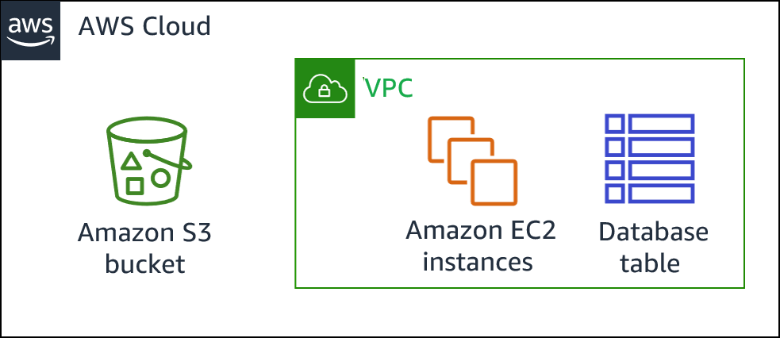
Shared Responsibility Example
Accounts and credentials
Customer responsibility examples:
Guest OS configuration
Application-level security
Security group configuration
Customer
AWS
AWS Global Infrastructure
Notes:
Consider an example where your company uses Amazon S3 to store data. Your AWS environment also includes EC2 instances and an Amazon Relational Database Service (Amazon RDS) instance. These resources run a MySQL database, which is deployed inside a virtual private cloud (VPC). One EC2 instance hosts a web server, and the web application that runs on it uses the database to store application data.
In this scenario, AWS is responsible for protecting the global infrastructure, which contains the physical servers that host the virtual machines and storage hardware. These virtual machines and storage hardware host your S3 bucket, EC2 instances, and database instance. AWS is responsible for the security of the physical networking infrastructure that ensures that these components can be accessed. AWS is also responsible for the security of the hypervisor layer that hosts the EC2 instances. (The hypervisor is the host OS that runs the EC2 instances, which are virtual machines that run guest operating systems.)
You (the customer) are responsible for managing the guest OS that runs on the EC2 instances (including Microsoft Windows or Linux OS updates and security patches). You are also responsible for managing any application software or utilities that you install. Additionally, you are responsible for the configuration of the security groups that control network access to each EC2 instance and to the RDS database instance. You are also responsible for configuring security on the S3 bucket and the objects that you store in it. For example, you could use one or more of the security features that AWS provides, such as bucket policies, data encryption, and S3 Block Public Access.
For more information, see Shared Responsibility Model at https://aws.amazon.com/compliance/shared-responsibility-model.

Slide 19
Security in the cloud
Customer data
Platform, applications, identity and access management
Customer
Operating system, network and firewall configuration
Client-side data encryption and data integrity, authentication
Server-side encryption
(file system and/or data)
Network traffic protection
(encryption/integrity/identity)
Considerations
What you should store
Which AWS services you should use
Which Region to store data in
What content format and structure to use
Who has access
Notes:
While AWS secures and maintains the cloud infrastructure, you are responsible for securing everything that you put IN the cloud.
Before you architect any workload, you need to put practices in place that influence security. You will want to control who can do what. In addition, you want to be able to identify security incidents, protect your systems and services, and maintain the confidentiality and integrity of data through data protection. You should have a well-defined and practiced process to respond to security incidents. These tools and techniques are important because they support objectives such as preventing financial loss or complying with regulatory obligations.
Because AWS physically secures the infrastructure that supports our cloud services, as an AWS customer you can focus on using services to accomplish your goals. The AWS Cloud also provides greater access to security data and an automated approach to respond to security events.
When using AWS services, you maintain complete control over your content and are responsible for managing critical security requirements, including the following:
The content you choose to store on AWS
The AWS services that are used with the content
The country in which that content is stored
The format and structure of that content, and whether it is masked, anonymized, or encrypted
Who has access to that content, and how those access rights are granted, managed, and revoked
You retain control of what security you choose to implement to protect your own data, platform, applications, identity and access management, and operating system. This means that the shared responsibility model changes depending on the AWS services that you use.

Slide 20
IAM fundamentals
Securing Access to Cloud Resources
Notes:
This section covers fundamental information about the AWS Identity and Access Management (IAM) service.

Slide 21

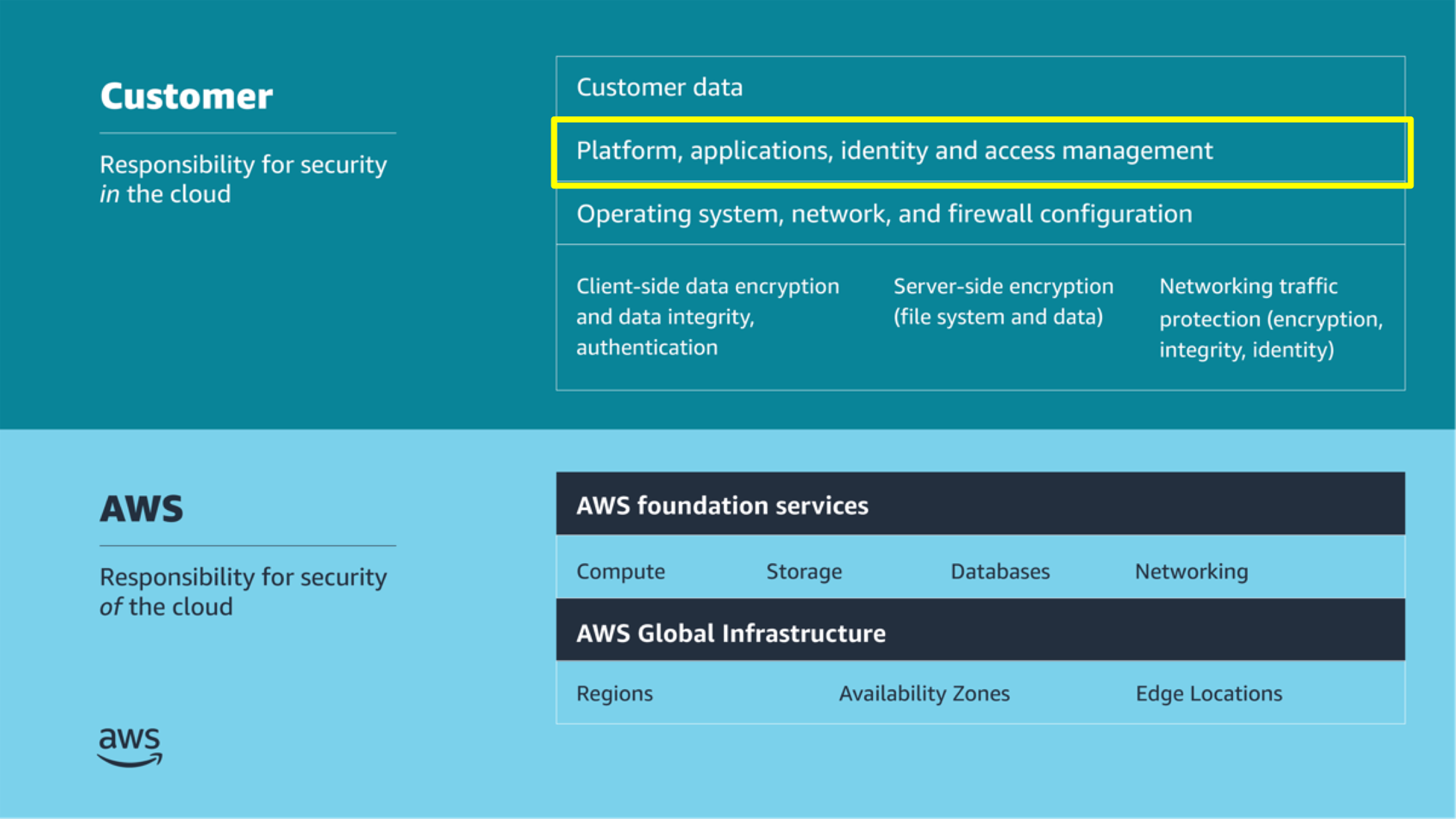
AWS Identity and Access Management (IAM)
IAM is a web service that helps you to securely control access to AWS resources.
Use IAM to control who is authenticated (signed in) and authorized (has permissions) to use resources.
AWS Identity and Access Management (IAM)

Slide 22




IAM overview
User
Group
Role
IAM policy
A person or application that can authenticate with an AWS account
A collection of IAM users who are granted identical authorization
An identity used to grant a temporary set of permissions to make AWS service requests
The document that defines which resources can be accessed and the level of access to each resource
Notes:
You can use IAM to control access to your AWS resources. You achieve this access control by creating users, groups, and roles. You can also enforce access control by attaching policies.
For IAM, these terms are defined as follows:
An IAM user is an entity that you create in AWS to represent a person or application that interacts with AWS account services and resources. A user is given a permanent set of credentials, which stay with the user until a forced rotation occurs. With new AWS accounts, the root user account is the first IAM user account established.
An IAM group is a collection of IAM users. You can use groups to grant the same set of permissions to multiple users.
An IAM role is similar to a user in that it’s an AWS identity that you can attach permission policies to. These will determine what the identity can and can’t do in AWS. However, a role doesn’t have long-term credentials (such as a password or access keys) that are associated with it. Instead, when a person or application assumes a role, they are provided with temporary security credentials for the role session. IAM roles will be covered later in this module.
An IAM policy is a document that explicitly lists permissions. The policy can be attached to an IAM user, an IAM group, an IAM role, or any combination of these resources. IAM policies will be discussed in more depth later in this this module.
To configure long-term access, a best practice is to attach IAM policies to IAM groups, and then assign IAM users to these IAM groups. An IAM user who is a member of an IAM group inherits the permissions that are attached to that group. You can also attach IAM policies directly to an IAM user to further customize the access that’s granted through the group.
For more information, see Security Best Practices in IAM in the AWS Identity and Access Management User Guide at https://docs.aws.amazon.com/IAM/latest/UserGuide/best-practices.html.

Slide 23
IAM roles
An IAM role is very similar to an IAM user, in that it is an identity with permission policies that determine what the identity can and cannot do in AWS. However, a role does not have any credentials (password or access keys) associated with it. Instead of being uniquely associated with one person, a role is intended to be assumable by anyone who needs it.
When you use IAM roles, you don’t need to grant long-term security credentials to each entity that requires access to a resource. An IAM user can assume a role to temporarily take on different permissions for a specific task.

Slide 24
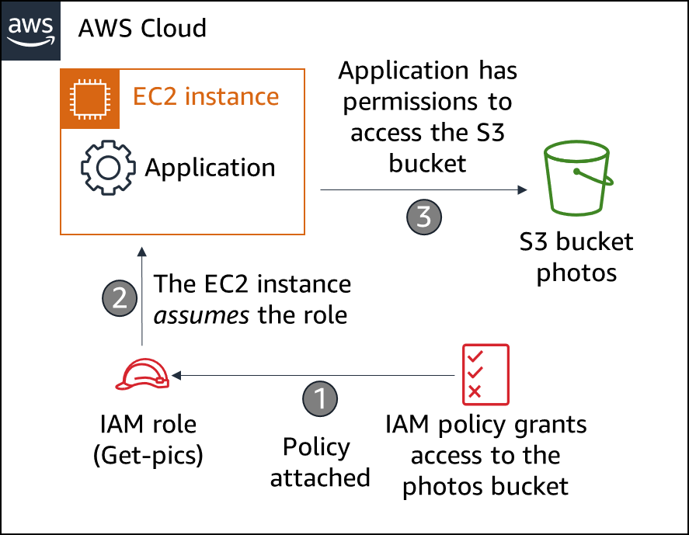
IAM Roles Example
The example illustrates a situation when you might need to use temporary security credentials to provide a role for an EC2 instance:
An administrator creates the Get-pics role in IAM, defines a policy that grants access to an Amazon Simple Storage Service (Amazon S3) bucket named photos, and attaches the policy to the role.
An EC2 instance assumes the Get-pics role.
The EC2 instance is granted temporary permissions to access the S3 bucket named photos.

Slide 25
Authorizing with IAM
Securing Access to Cloud Resources
Notes:
This section describes using IAM for authorization.

Slide 26
Identity-based and resource-based policies
Identity-based policies
Resource-based policies
What does a particular identity have access to?
Who has access to a particular resource?
Carlos
Resource | Read | Write | List
Resource X | Allow | Allow | Allow
Resource X
User | Read | Write | List
Ana | Allow | Allow | Allow
Akua | Allow | Allow | Allow
Mary | Allow | N/A | Allow
Mateo | N/A | N/A | Allow
Richard
Resource | Read | Write | List
Resource Y | Allow | N/A | N/A
Resource Z | Allow | N/A | N/A
Resource Y
User | Read | Write | List
Paulo | Allow | Allow | Allow
Nikki | Allow | N/A | N/A
Mateo | N/A | Allow | Allow
Managers
Resource | Read | Write | List
Resource X | N/A | N/A | Allow
Resource Y | N/A | N/A | Allow
Resource Z | N/A | N/A | Allow
Notes:
Note: In the tables on the slide, N/A means not applicable because the policy doesn't specify permissions for that particular action.
To reiterate, two types of IAM policies can grant permissions: identity-based policies and resource-based policies. The difference between the two types of policies is a result of where they are applied, which depends on the type of access that you're authorizing or restricting.
Identity-based policies are attached to an IAM user, group, or role. They indicate what that identity can do. For example, you could grant a user the ability to access an Amazon DynamoDB table.
Resource-based policies are attached to a resource. They indicate what a specified user (or group of users) is permitted to do with the resource. For example, you can use resource-based policies to grant access to an S3 bucket or to grant cross-account access between two trusted AWS accounts.
For more information, see Identity-Based Policies and Resource-Based Policies in the AWS Identity and Access Management User Guide at https://docs.aws.amazon.com/IAM/latest/UserGuide/access_policies_identity-vs-resource.html.

Slide 27
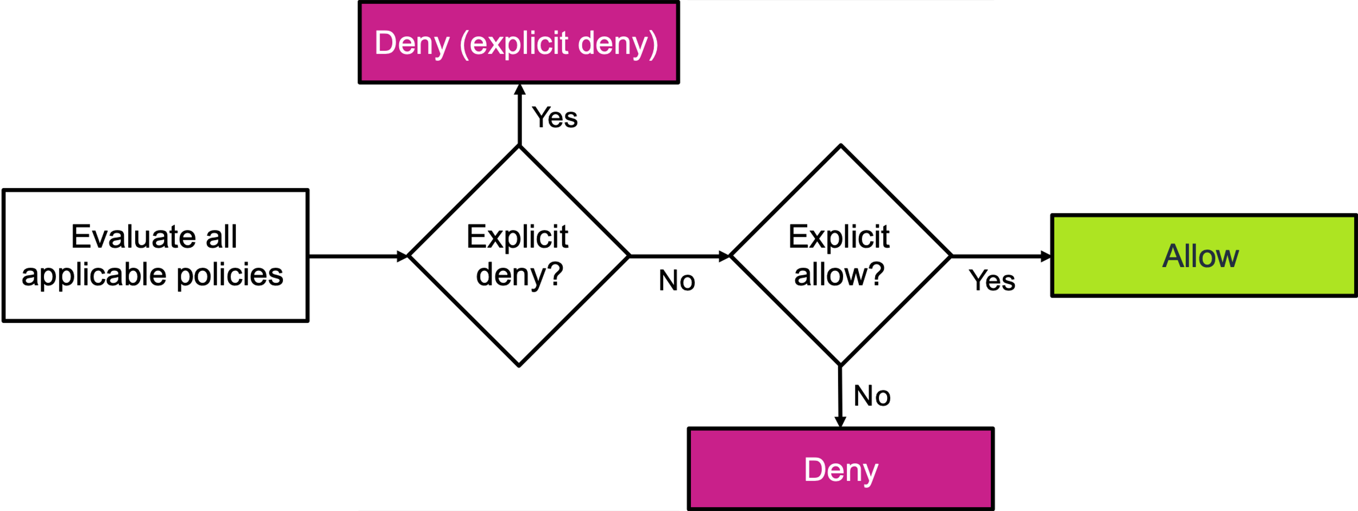
Evaluation logic for IAM policies
Notes:
For accessibility: Diagram of evaluation logic for IAM policies. Policies are evaluated first for an explicit deny. If an explicit deny exists, then access is denied. If no explicit deny exists, the policy is then evaluated for an explicit allow. If an explicit allow exists, access is granted, but if no explicit allow exists, access is denied. End of accessibility description.
This diagram shows the logic that AWS uses when evaluating IAM policies. AWS evaluates all applicable policies and goes through this evaluation logic:
By default, all requests are denied.
An explicit allow overrides the default deny.
An explicit deny overrides any explicit allow.
The order that the policies are evaluated in has no effect on the outcome of the evaluation. All policies are evaluated, and the result is ​always​ that the request is either allowed or denied. Suppose that a conflict occurs (one policy allows an ​action​ and another policy denies an ​action​). Then the most restrictive policy (that is, the policy that denies the ​action​) is applied.
For additional information about evaluating and testing policies, see Testing IAM Policies with the IAM Policy Simulator in the AWS Identity and Access Management User Guide at https://docs.aws.amazon.com/IAM/latest/UserGuide/access_policies_testing-policies.html.

Slide 28
Summary
Overview of Virtualization and Cloud Computing
Cloud Deployment Models and Service Modules
Shared Responsibility Model
Identity and Access Management (IAM)

